Slide 1
Navigating Nuances in the Spring 2023 Market
Walk a Mile in Their Shoes
Continuing Education Class
www.campbellandbrannon.com/navigating

Slide 3
AGENDA
Section 1 – Who is your Seller?
Section 2 – What does this mean for Buyers?
Section 3 – Properties on the Market
Section 4 – Buyer and Seller Source of Funds and Finances

Slide 4
Who is your Seller?

Slide 5
Who is your Seller?
Homeowner’s who would typically be looking to move may be hesitant to list their current home. The source of a lot of listings will come from those who really need to sell. This may include but is not limited to:
Estates
Divorced Parties
RELO
Builders
Condo Owners

Slide 6
Estates

Slide 7
Estates
Who needs to sign a contract for property owned by an estate and who has the authority to sign can be tricky – call us if you have questions about it!
STEP 1: Obtain a copy of most recent deed (attorneys@cb.law).
STEP 2: Review and confirm: Did the parties hold title as Joint Tenants with Rights of Survivorship?
If YES, The remaining seller should sign the contract. Please request a copy of the Death Certificate for the deceased owner.
If NO, proceed to Step 3.
STEP 3: Ask: Has probate been filed and an Administrator/Executor been appointed?
If YES, Ask for copy of the Letters Testamentary or other Court Order appointing the Administrator/Executor of the Estate.
If NO, Probate Court will need to appoint someone to sell the property.

Slide 8
Estates
Remember! Powers granted under a POA terminate upon death!
Joint Tenants with Rights of Survivorship
Upon the death of an owner the decedent’s interest in the property automatically vests in the survivor(s).
The survivor(s) will sign in their individual capacity, and we will need a copy of the death certificate.

Slide 9
Estates
Executor
When the decedent leaves a Will that Will is probated and the executor is given power over the estate’s assets subject to the terms of the Will.
Request a copy of the Will and Letters Testamentary.
The Will typically names an executor, a successor, and the powers given to them.
The court issues Letters Testamentary giving them legal control over the estate.

Slide 10
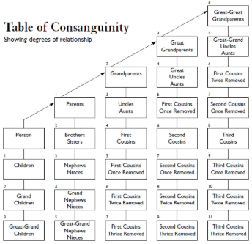
Estates
Administration
Used when the decedent didn’t leave a Will or the Will wasn’t accepted by the court.
Distribution of assets is dictated by Georgia’s intestate statutes
The probate court will appoint an administrator who has authority over the estate’s assets.
Letters of Administration issued by the court names the administrator and their powers.
Sometimes they are given all statutory powers but it may also be limited to specific duties.

Slide 11
Estates
Be careful! Just because the court issued Letters Testamentary or Administration doesn’t mean they automatically have the power to sell the property.
If the will has not yet been probated:
Technically, you must wait for an executor to be named
We have seen people use the signature of the proposed executor, but that is arguably unenforceable.
Until the Letters are issued no one legally has authority to sign on behalf of the estate or bind a contract on behalf of the estate!
If in doubt, ask a C&B attorney to review!

Slide 12
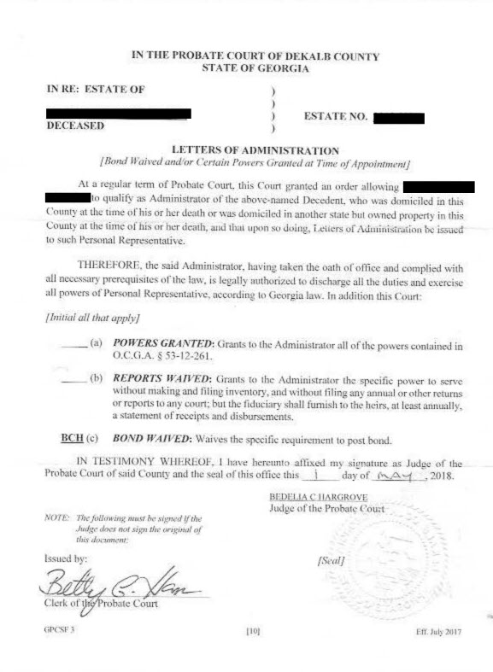
Estates
Letters of Administration where the administrator had to petition the court for leave to sell.

Slide 13
Estates
If there is no joint tenancy and both owners are deceased both estates will need to be probated. Both estates are sellers.
If there is no joint tenancy and one owner is deceased, the surviving owner and the deceased’s estate are sellers.

Slide 14
Estates
Signatures
______________________________
Sally Seller, as Executor of the Estate of Simon Seller, deceased
OR
______________________________
Sally Seller, as Administrator of the Estate of Simon Seller, deceased
On the GAR contract you can have it set up as:
Sally Seller, Executor .
Signature
Estate of Simon Seller .
Print Name

Slide 15
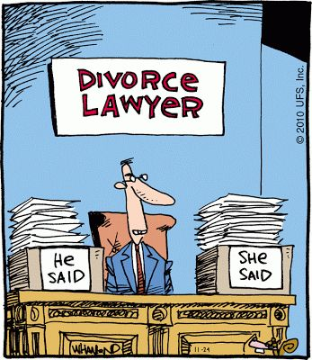
Divorce

Slide 16
Divorce
When owners get divorced their home is likely to be listed for sale even if they wouldn’t have previously thought of selling.
Questions to ask your divorced seller(s)?
Did you buy the house while married?
What is the current status of the divorce proceeding?
If the divorce is final/closed who was awarded the property?
A settlement agreement or a supplementary agreement may give very specific guidelines when listing the property and accepting offers – if possible, ask for a copy.

Slide 17
Divorce
If divorce is complete, we need a copy of the FINAL divorce decree and any settlement agreement that addresses the house and the sale.

Slide 18
Divorce
If the sellers are separated, have they filed for divorce?
Standing orders provide that once a divorce is filed, any martial property cannot be disposed of without a court order.
Exceptions exist but any agreement made during the pending divorce proceeding must be signed off on by both parties and their attorneys.
Even if they can’t agree to the split of proceeds, we may be able to close and send the proceeds to the divorce attorney’s escrow account to be held until the divorce is final.

Slide 19
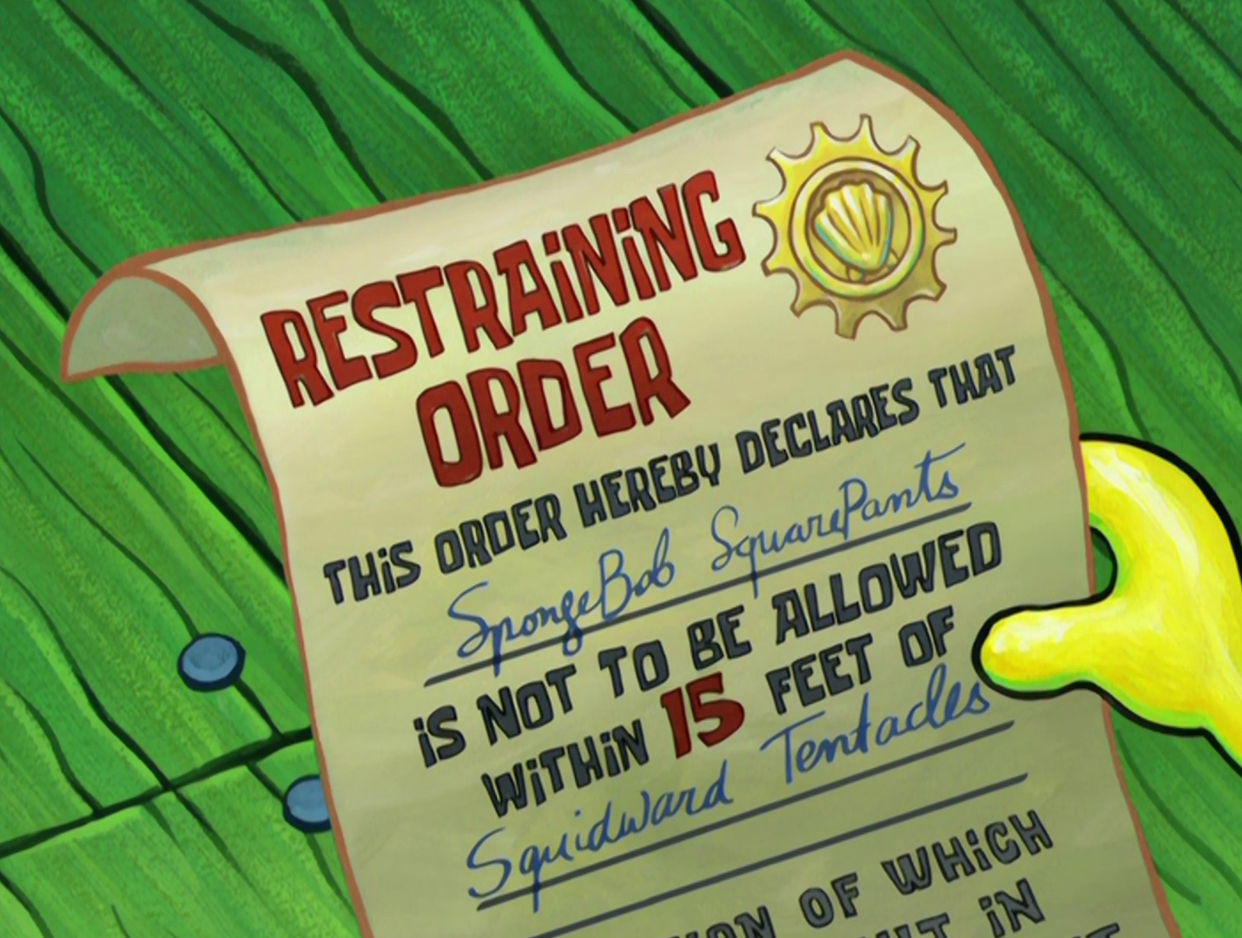
Divorce
Please let us know ASAP of any sensitive situations surrounding the divorce!
Is there a restraining order that prohibits
contact between the parties?
For a party’s safety do we need to redact
forwarding addresses or contact
information?
These are sensitive topics but please
communicate with us so we know how
to best help your client through this
emotional process.

Slide 20
Divorce
As the selling agent remember that equitable interest means if your client purchases property before their divorce is final, their new property could become subject to the divorce – unlikely to happen but good to keep in mind!
Quiz Time!
My divorce was final 5 years ago, why do you need to contact my ex, see the settlement agreement, etc.?
My ex never owned the property why do you need the settlement agreement?

Slide 21
Builders

Slide 22
Builders
Remember! Builders broke ground on many of these properties in a very different economic climate.
Although higher interest rates impact builders they don’t feel it quite the same way as the individual home buyer.
Builders want to close as quickly as they can after getting the CO to help cut their carrying costs.

Slide 23
RELO

Slide 24
RELO
What is RELO?
It is when a purchaser or seller’s company is transferring or hiring the purchaser or seller and the company is paying for their moving costs.
How is RELO different?
Read RELO paperwork and addendums carefully as they may override the GAR forms.

Slide 25
RELO
Typically:
The third-party relocation company is involved from beginning to end.
RELO companies often work with specific approved teams
Sellers and buyers can choose their own agents, but RELO may include a list of preferred agents
We often run the title exam and clear any title issues prior to the home being listed
Practice Tip:
Be mindful before signing up as a referral agent for a RELO company – read the referral fee carefully
You can still request to close with C&B!

Slide 26
RELO – the Process
RELO closing attorney clears the title in advance and prepares the seller closing documents.
Seller signs the deed and closing documents in advance and go ahead and move.
Property listed and goes under contract – the RELO company typically signs the contract.
RELO completes an equity buyout ahead of closing and will be shown as the seller on the contract.
Seller and RELO approve the settlement statement days in advance of closing.
Buyer closes on the property.

Slide 27
RELO – What to Expect
The RELO contract addendum may include language that overrides the GAR forms. This often includes:
Buyer paying all HOA fees, regardless of the CAD; or
Due diligence timelines and requirements may be altered
The buyer will negotiate with the homeowner, but RELO is technically the seller and signs the contract.
Commonly, RELO will not sign until all ducks are in a row – this includes the Earnest Money Deposit.
A RELO company will often do a home inspection before the equity buyout, but the buyer should still get their own.

Slide 28
What does this mean for Buyers?

Slide 29
Estates
Although the home may need significant work there is a good chance the executor of the estate is emotionally connected to the house.
Telling the seller you are going to tear down their childhood home might not go down too well.
The estate may not have extra funds to cover the costs of repairs out of pocket.
An executor is less likely to be willing to make repairs and more open to the idea of higher closing costs or paying a vendor for the repairs at closing.
The executor likely doesn’t have knowledge about everything regarding the house – remember buyer beware!
If probate is still pending be flexible on the closing date.

Slide 30
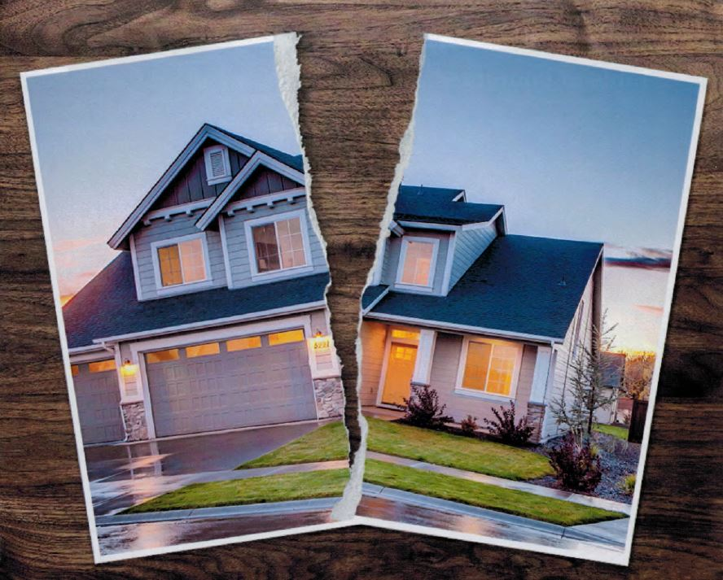
Divorce
If the divorce is contentious the sellers may have a difficult time getting on the same page regarding repairs or additional stipulations.
Is the divorce final? Will the sellers need a flexible closing date to accommodate any potential approvals from the court?

Slide 31
Builders
If you agree closing will occur ___ days after a particular step is complete, you should still put an outer limit on the closing date – don’t leave the buyer hanging for months and months on end if the builder is dragging their feet.
Builders may require buyers make a nonrefundable payment for upgrades.
Although the market has shifted, building costs have increased and builders must keep their break even point in mind .
Remember! Many builders designed homes and invested in them many months ago. They may not have anticipated the jump in interest rates – this narrows the pool of potential buyers while at the same time increasing their carrying costs.

Slide 32
RELO
RELO companies typically don’t love lots of contingencies.
Carefully read any contract terms or literature provided by the company – if you have questions about it give us a call!
Many won’t pay for repairs or provide home warranties.

Slide 33
Create Goodwill
Although buyers are slowly acquiring more negotiating power the ball is still in the seller’s court.
Be realistic in the offer presented to the seller – keeping their circumstances in mind.
Don’t go in blind demanding something that isn’t realistic for the seller.
Older homes may require specialized vendors or special-order repair parts that can’t be delivered and/or installed before closing or the repair cost may be cost prohibitive for the seller to come out of pocket.

Slide 34
Create Goodwill
Remember that an existing home is not new construction!
Every home has some level of deferred maintenance we all live with - there is a big difference between an inspection showing an AC filter that needs to be cleaned vs. needing a whole new system.
Don’t expect to move into a perfectly new home – unless it is a completely new home!

Slide 35
Properties on the Market

Slide 36
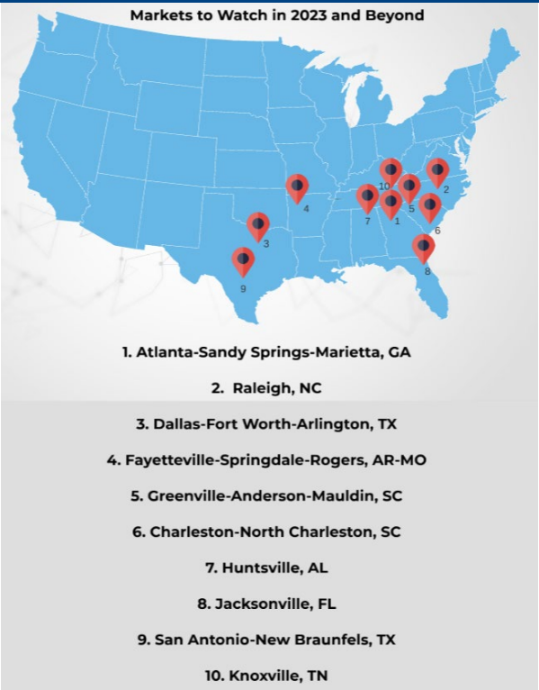
Outlook
National Indicators Considered:
Better Housing Affordability;
More Renters who can Afford to Buy the Median-Priced Home;
Stronger Job Growth;
Faster Growth of Information Industry Jobs;
Higher Share of the Information Industry in the Local GDP;
Migration Gains;
Share of Workers Teleworking;
Faster Growing Population;
Faster Growth of Active Inventory; and
Smaller Housing Shortage.
©2022 National Association of REALTORS®

Slide 37
Outlook
The Atlanta-Sandy Springs-Marietta metro areas was the only area (out of 179 markets) that meet all 10 indicators.
The Atlanta metro area continues to be more affordable than other markets around the country. In Atlanta, more than 20% of renters could afford to buy a typical Atlanta area home.
Our job market is robust, with many major companies opening offices here. Contributing to Atlanta’s substantial population growth.
©2022 National Association of REALTORS®

Slide 38
Foreclosures
Although home sales have slowed, prices are staying relatively stable. This price stability keeps foreclosure rates down.
According to Black Knight, mortgage delinquency is down 9% since December 2021 and foreclosure rates are still 30% below pre-pandemic levels.
Generally, homes are not underwater so those facing foreclosure can sell their property and still walk away with some equity in their pocket.
CoreLogic found that in 2022, the average American household has nearly $300,000 in equity.
* Remember these statistics are nationwide and Atlanta is one of the markets with the best outlook for 2023!

Slide 39
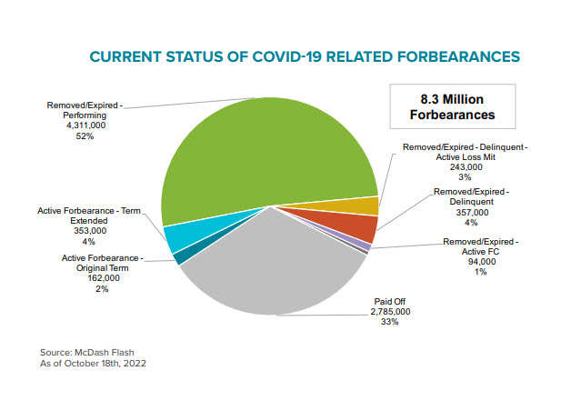
Foreclosures
As forbearance programs come to an end, homeowners who can’t make payments are more likely to list their property rather than walk away.
According to Black Knight only 1% of expired forbearances are in active foreclosure.
©Black Knight Financial Technology Solutions, LLC

Slide 40
Short Sale
Short Sale means that upon sale you do not have enough
equity in your property to pay off your mortgage.
During the Obama administration there were multiple
programs in place to encourage banks to accept short sales.
These programs have largely expired and lenders are no
longer incentivized to go down the short sale path.
Short Sale is generally utilized for underwater property
but very few homes are underwater right now.
Black Knight determined that although collectively homeowner equity declined by $1.3 Trillion in Q3 of 2022, the average homeowner still gained $92,000 in equity since the start of the pandemic. Black Knight also found less than 500,000 homes nationwide to be underwater.

Slide 41
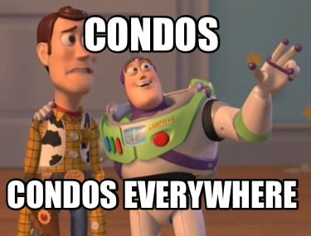
Condos
In some markets, condos may be the only affordable option left. Buyers who didn’t previously consider condos might be more open to exploring this option.
Condos are often purchased by first-time homebuyers. These first-time home buyers may have had significant life changes since purchasing and are now ready to sell.
There is a big difference between deciding to sell because you want more closet space and selling because you are now married, have two dogs, a baby, and another one on the way all in a one-bedroom condo.
Condos will become a higher percentage of listings while at the same time providing an affordable option for buyers!

Slide 42
Condos
What’s the Difference?
Townhome
A form of ownership where the owner owns not only the townhome unit but also the land underneath. Depending on the covenants for the development the owner may or may not be responsible for the roof, deck, patio, landscaping, etc.
Condominium
A form of ownership where the owner owns only their unit and a shared interest in common areas. Typically, the walls, ceiling and floor are the boundaries to each unit and the owner does not own the land beneath their unit. Remember, a condo is a style of ownership not a particular type of property!

Slide 43
Condos
What does the buyer really own?
The buyer of a condominium home owns his or her unit plus a pro rata interest in common elements serving all of the owners in the condominium. The boundaries of the unit are normally described three dimensionally with both vertical and horizontal boundaries.
What is a common element?
Property that everyone shares – ex. pool, gym, courtyard, lobby
What is a limited common element?
Property that is reserved for exclusive use of specific owners - ex. Parking space, storage area, balcony

Slide 44
Condos
Condo Benefits
Insurance - often cheaper because association master policy covers the common elements
Amenities!
Some include utilities in their monthly assessment
Lower upkeep cost

Slide 45
Condos
Although more affordable remember there are additional expenses to consider:
Monthly Assessment: Also known as the HOA dues; this covers the cost and upkeep of common and limited elements, insurance, maintenance, concierge services, etc. The cost typically varies per unit based on square footage. *Be aware, it is common for this amount to increase year after year.*
Initiation Fee: A onetime cost to join the HOA. On occasion it is 2x the monthly assessment. ($300/month assessment = $600 initiation fee.)
Capital Contribution: A onetime cost when joining the HOA. Also known as a reserve fund for the community. Often will be used for major building repairs/upgrade. Not all condos have this fee. Examples of what CC would cover: new roof, exterior paint, pool remodel, etc.
Move In/Move Out Fee: A cost for when moving into and out of the community. Sometimes this is refundable. This can be used to reserve the elevator, concierge assistance, damage deposit, etc.
Special Assessment: Paid by all owners at the time of assessment being approved. Typically voted on by the community for repairs/updates to common areas. At times it will be a lump sum; others it will be paid over a certain timeframe. Ex – new roof, updated key fob system, hallway remodel, etc.
Account Statement/Clearance Letter: A letter the HOA provides to the closing attorney to show what is due at closing. Typically, there is a cost to receive this letter. According to the CAD – the seller pays this cost.
Miscellaneous: A condo owner can also expect to pay for Building Fobs, Keys, Mailbox Keys, Pool Cards, etc.

Slide 46
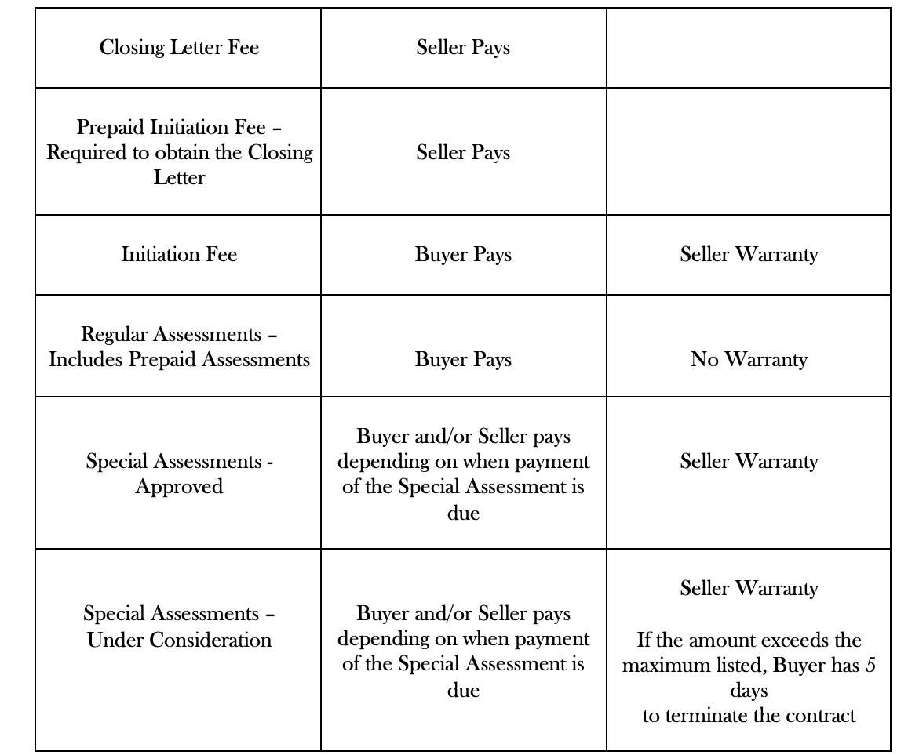
Condos

Slide 47
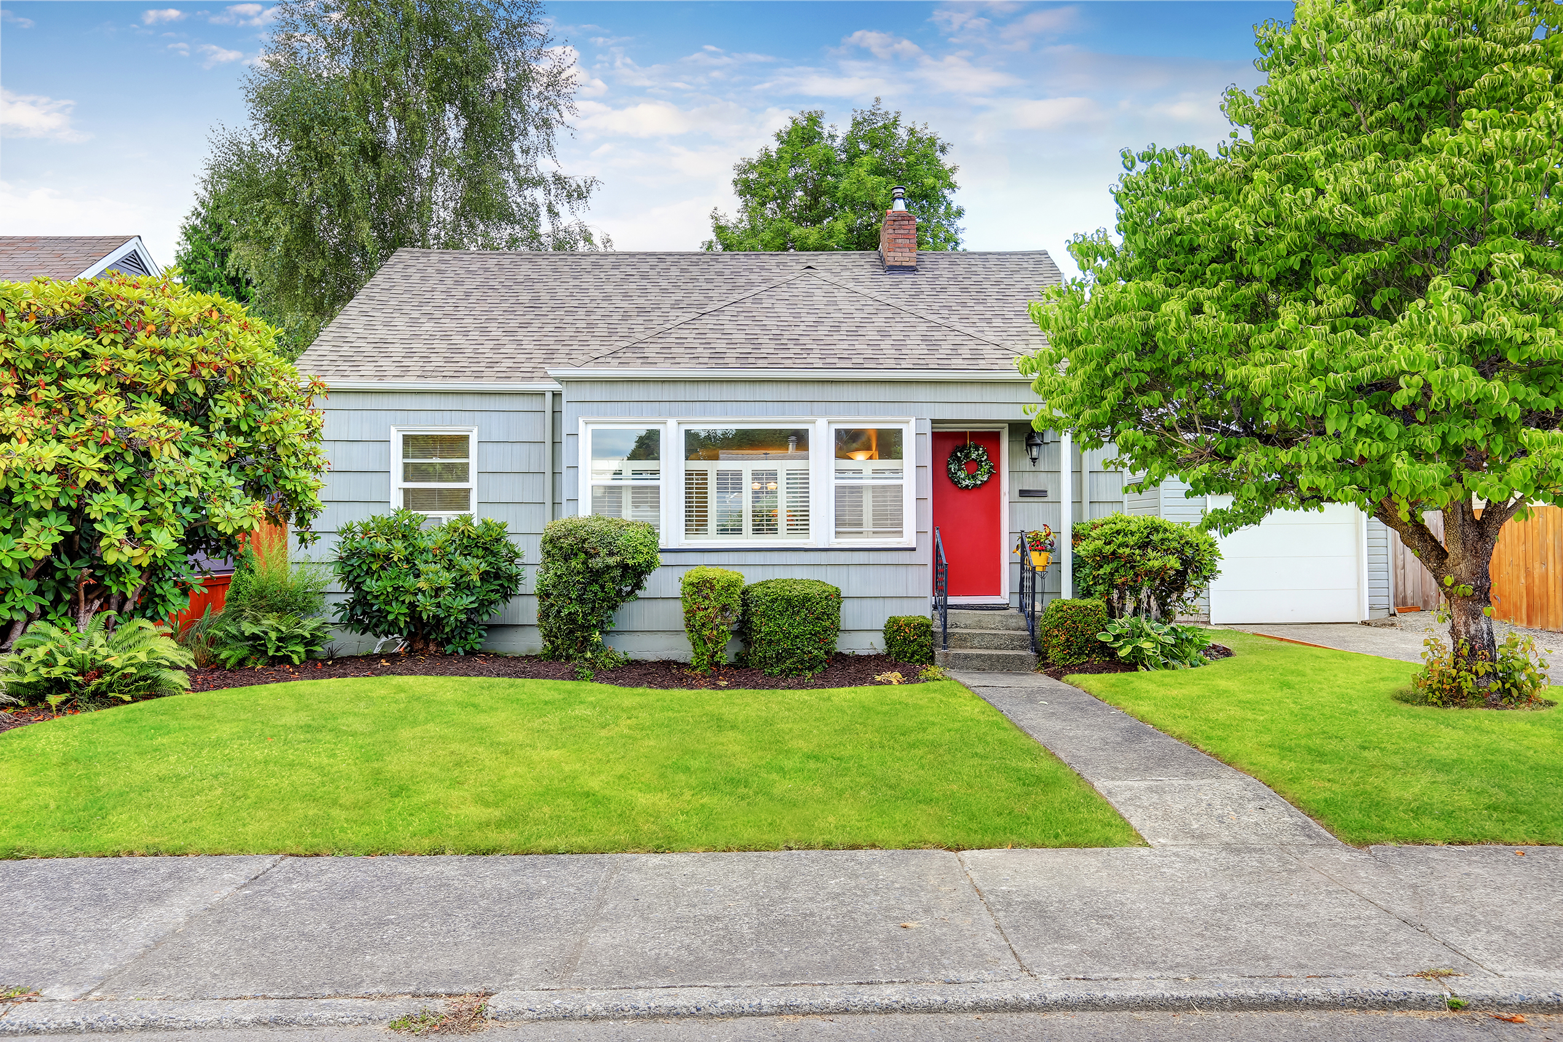
Short-Term Rentals
If your buyer wants to purchase property for short-term rental (i.e. Airbnb) check HOA restrictions.
Most jurisdictions now have regulations in place limiting short-term rentals. Even if they are allowed there may be special licenses or permits to apply for, regulations on the type of rental allowed, etc.

Slide 48
Buyer and Seller Source of Funds and Finances

Slide 49
Contingencies and Source of Funds
Remember these are contingencies meaning if the conditions aren’t met the parties have the right to terminate.
Black’s Law Dictionary 2nd Ed. defines contingency as: “An event that may or may not happen, a doubtful or uncertain future event. The quality of being contingent. A fortuitous event, which comes without design, foresight, or expectation. A contingent expense must be deemed to be an expense depending upon some future uncertain event.”

Slide 50
Contingencies and Source of Funds
Verification of Funds in the No Financing Contingency (F401)
Check the date on the source of funds – it must be dated subsequent to the binding agreement date or if providing a statement it must be for the regular time period for the period immediately before the binding agreement date
Remember stocks are not liquid funds and their value is subject to change from biding agreement date until closing.
Cryptocurrency is very volatile and not a good source of funds.
Verification of funds must be in US Dollars.
Your buyer must be willing to liquidated their stocks or bonds to purchase the property.
The buyer should talk to their financial advisor to discuss the timeline for liquidating and the associated tax consequences.

Slide 51
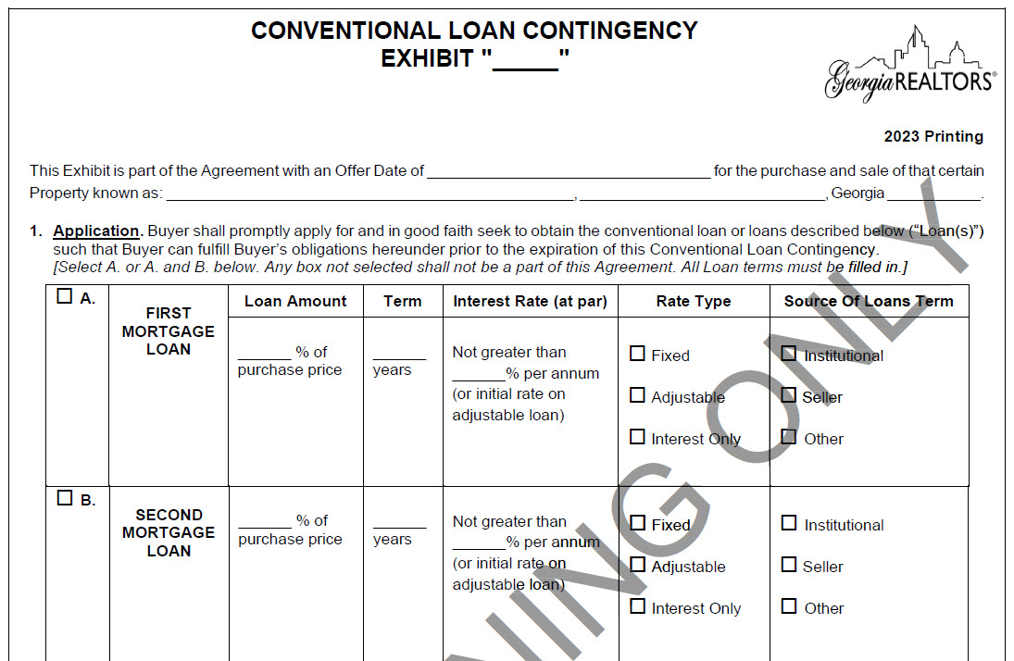
Contingencies and Source of Funds
Conventional Loan Contingency (F404)
Buyer may apply for any conventional loan, but the contract is contingent only on the loan described in section 1.
Must notify the seller of loan denial during the contingency period but buyer has 7 days to provide the loan denial letter – this is true even if the 7 days is outside of the contingency period.
If the buyer qualifies for a loan but that loan has less favorable terms than the terms outlined – no matter how small that difference is the buyer could terminate.

Slide 52
What Happens When You Assume (Loans)?
An assumable loan it is a great marketing feature! With rising interest rates, buyers are hesitant to be locked into higher payments. However, assuming an existing loan is a way to combat these fears!
If a property has an assumable loan with a low rate it is attractive to potential buyers.
Buyer takes on the original mortgage terms – the buyer will need to cover the difference for the equity with another loan or cash. HELOCS are commonly used to cover this difference.
Sellers should never agree to an assumption unless they are released from all financial responsibility for the mortgage (this is called Novation) – this means the buyer will need to go through underwriting with the seller’s mortgage company.

Slide 53
How Do Loan Assumptions Work?
The buyer takes title to the property the same as they would in any traditional closing.
Seller signs the limited warranty deed and receives their proceeds after closing.
The difference is that the buyer is taking over the seller’s existing loan, rather than applying for a new one.
The buyer adopts the outstanding principal balance, interest rate, terms, etc.

Slide 54
Assumable Loans
Can my loan be assumed?
Conventional Loans: most have a due-on-sale clause and are not assumable. Some conventional ARMs may be assumable provided you don’t convert to a fixed rate;
FHA loans: generally assumable with lender approval;
VA loans: assumable with lender approval BUT VA
entitlement is not available to the seller until
the loan is paid off UNLESS the loan is assumed
by another eligible veteran;
USDA: assumable but usually requires a new rate
and term

Slide 55
What About the Equity?
Although the buyer is assuming the loan they must still cover the seller’s equity at closing.
i.e. If there is a $600K property with a $450K loan balance, buyer would have the cover the $150K “gap”
Buyer can apply for a second loan to cover the gap. Although this second loan will be at a higher rate, it will be on a much lower principal balance.

Slide 56
Pros and Cons
Pros
Makes lower interest rates available to the buyer;
Allows a seller to market the property with a variety of financing options;
While most sellers shield away from seller financing a loan assumption removes any of their obligations concerning the property;
Potentially lower loan costs and closing costs for the buyer – won’t have to pay intangible tax on the loan.
Cons
Most conventional loans are not assumable;
Typically offered only for government-backed loans;
When there is significant equity in the property it may be difficult for a buyer to cover the equity gap.

Slide 57
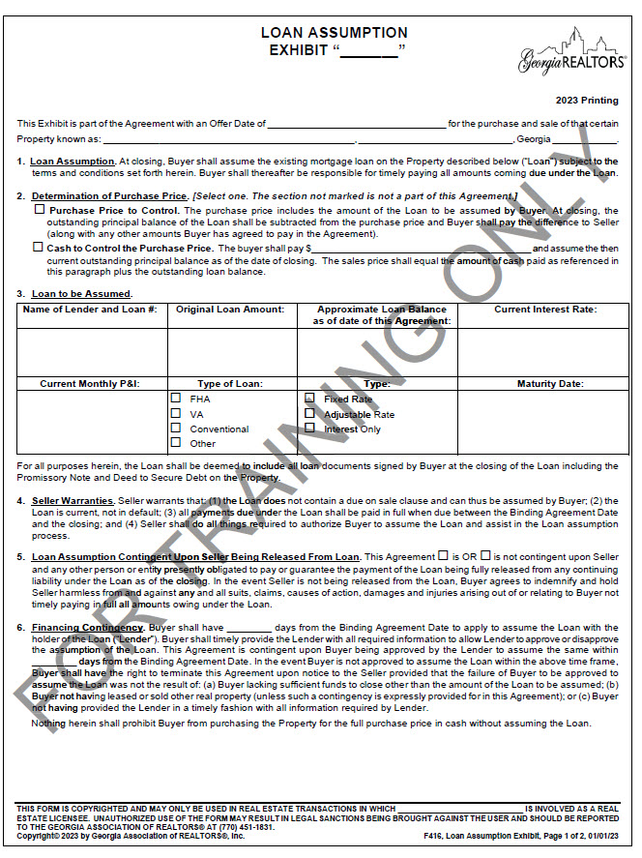
Assumable Loans
Use the Loan Assumption Exhibit (GAR 416).
F416 :
Allows you to structure the purchase price around the assumable loan;
Provides a contingency for lender’s approval of the Loan Assumption; and
Includes an appraisal contingency and the ability to request source of funds.

Slide 58
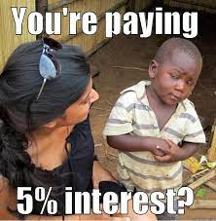
Refinance
Marry the Property, Date the Rate!
The property is forever, the rate is temporary.
A future refinance could lock in a lower rate or convert an ARM to fixed rate

Slide 59
Refinance
Recasting and modifications are NOT refinances – the behind-the-scenes structure is very different
Refinance: the origination of a new mortgage and using the funds from the new mortgage to payoff the existing mortgage.
Recasting: when the borrower makes a large lump-sum payment to the principal. The lender then reamortizes your balance. This is commonly used when buyers close on the sale of their prior home after the purchase of their new home.
Modification: you keep the same mortgage but the loan terms are adjusted.

Slide 60
Refinance
Refinance Procedure
Apply for the new mortgage with a loan officer. They will then send your loan application to their underwriters for review.
The underwriting process will look similar to when you first purchased the property.
Just like a purchase, a refinance in Georgia must be done through a closing attorney.
If you are refinancing your primary residence, there is a 3 day right of recission. During that time the borrow can rescind the agreement and get their money back. The refinance will not be finalized until the recission period ends.
What about second mortgages, HELOCS, etc.?
They will need to be paid off or subordinated. Some secondary mortgages may
not allow subordination.

Slide 61
Refinance
Benefits of refinance: take advantage a of a lower interest rate or change your loan terms.
Loan Type | Requirements
Conventional | No seasoning requirement for rate and term refinances. 6 month seasoning for cash-out
FHA | 7 month seasoning for rate and term refinances 12 months for cash-out
VA | After 210 days or six consecutive payments – whichever is longer
USDA | 12 month seasoning period for all loan refinances
When can you refinance?
Timeline will vary based on the loan type and purpose of the refinance.
Generally, you must own the property for a minimum of 6-12 months before qualifying for a cash-out refinance.

Slide 62
Refinance
Closing Costs: most lenders will allow you to roll closing costs into the new mortgage. If your current mortgage has a prepayment penalty, check the fine print.
Title : you do not need to purchase a new owner’s policy, but your lender will require a new lender’s policy.
We offer discounted rates on refinance transactions. The settlement fee is reduced to $475!
Since we already did a title exam when you purchased the property, we only need to run title from your closing day forward – this reduces the title exam cost to $75.

Slide 63
Refinance
One of the biggest cost saving measures is the potential intangible tax break.
The intangible tax is charged on all recorded security deeds with a maturity date greater than 3 years. This tax is charged at $1.50 per five hundred dollars of the loan amount.
However, when refinancing with your original mortgage lender intangible tax is only paid on the difference between the unpaid principal and new loan amount.
Be careful! This intangible tax break only applies if the borrowers
are the exact same and your original mortgage lender still owns
the original note.

Slide 64
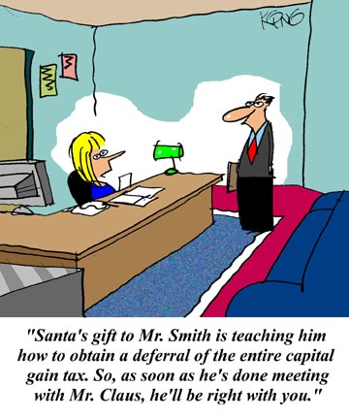
1031 Exchange
Commonly Referred to as:
a 1031 Exchange;
a Starker Exchange from the 1979 federal court case that validated the delayed exchange process;
a Like-kind Exchange; or
a 1031 Tax-Deferred Exchange

Slide 65
1031 Exchange
What does it do?
Allows a seller to defer paying capital gain taxes on the sale of an investment property when that seller reinvests the sale proceeds into a new investment property.
Provides for greater purchasing power.
Builds and preserves wealth.
As an Estate Planning Tool - allows wealth to be passed on to future generations tax-free.

Slide 66
1031 Exchange – Tax Deferral Tool
The gain on a sale, not the profit or equity, is subject to both capital gain taxes (federal and state) and a depreciation recapture tax.
A 1031 exchange allows a seller to defer all capital gains on the sale of an investment property.
Remember! This is NOT an exemption from paying taxes on the gain, but rather a delay or deferral of that tax.

Slide 67
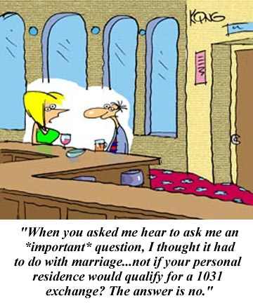
1031 Exchange – What is “Like-Kind”
“Like-kind” has a very broad definition – Real property that has been and will be held for productive use in the investor’s trade/business or for investment. For example, you can trade raw land for a duplex or an office building for a working farm.
A primary residence does not qualify. Vacation homes can be tricky! More on this later.

Slide 68
1031 Exchange – What is “Like-Kind”
1031 exchange does not apply to the gain recognized on the sale of a principal residence.
A property is deemed your primary residence for tax purposes if you resided there two of the last five years – those two years don’t need to consecutive.
Exemptions from taxation on capital gain on sale of a personal residence
$500,000 for married couples who file jointly
$250,000 for single person.

Slide 69
1031 Exchange – The Process
Seller/Exchanger enters a contract to sell an investment property. This is called the “Relinquished Property”;
Seller/Exchanger enters into an Exchange Agreement with an exchange agent known as a “Qualified Intermediary” or “QI”;
Family members or anyone who is an agent of the seller, including seller’s attorney or CPA, may not serve as the QI.
Seller/Exchanger assigns rights in the purchase & sale agreement to the QI.
Upon the closing of the Relinquished Property, the sale proceeds are wired to the QI.
For a valid exchange, it is imperative that the seller not receive the sale proceeds.
What happens next?

Slide 70
1031 Exchange – The Process
Important Time Limits:
The Exchanger has 45 Days from the Closing of the Relinquished Property during which to identify up to 3 “Replacement Properties.”
The Exchanger has 180 Days from the Closing of the Relinquished Property to close on the “Replacement Property.”
The 45 Day and 180 Day Timelines run concurrently.
Example: if the Exchanger identifies Replacement Property on day 45, he will have 135 days remaining to close on the Replacement Property.
In the current market, investors typically are under contract when they identify the Replacement Property

Slide 71
1031 Exchange – Other Considerations
For maximum benefit, Exchanger should attempt to purchase Replacement Properties that is equal to or greater in value than the Relinquished Property.
Reinvest all equity in the Replacement Property.
Remaining funds being held by the QI after acquiring the Replacement Property will be released to the Exchanger at the end of the 180-day exchange period. Those funds released to the Exchanger will be taxed as partial sale proceeds and be subject to capital gains taxes.
Obtain equal or greater debt on the Replacement Property. A Reduction in liability can result in taxation.
Example: If there is a mortgage of $500,000 on the Relinquished Property but only $400,000 on the Replacement Property, the Exchanger may have $100,000 of taxable gain.
**It is vital that you advise your clients to consult with their tax and legal advisors**

Slide 72
1031 Exchange – Other Considerations
Through the Stepped Up Basis, the deferred tax liability may be eliminated at the owner’s death. Tax-deferred essentially becomes Tax-Free!
Can a 1031 Exchange be used for Vacation Homes? It depends!
A great option for smaller builders – could be used in conjunction with option agreements.

Slide 73
1031 Exchange – Key Takeaways
Property sold and property purchased must be like-kind;
Investment/business property only;
Replacement Property should be greater or equal value to maximize tax benefit;
The difference between Relinquished Property and
Replacement Property will become subject to capital
gain taxes;
Must be the same taxpayer!
45 days to identify Replacement Property; and
180 days to close on Replacement Property.

Slide 74
1031 Exchange – Other Considerations
Practice Tip! Use the GAR Special Stipulations regarding 1031 Exchange utilization

Slide 75
1031 Exchange – Exchange Agents
Whitney Brennan
IPX 1031 (Investment Property Exchange Services, Inc.)
Whitney.Brennan@ipx1031.com
916-806-1468
Rachel Hollinger Chapman
IPX 1031 (a division of Fidelity)
Rachel.Hollinger@nticny.com
678-492-5776

Slide 76
Questions?
attorneys@cb.law

